Slide 1
Customer Churn Analysis
Presented by: Harsh Katariya

Slide 2
Overview
The goal of this project is to predict customer churn in a telecom company using machine learning techniques. By identifying at-risk customers early, the business can take proactive steps to retain them and improve long-term profitability.

Slide 3
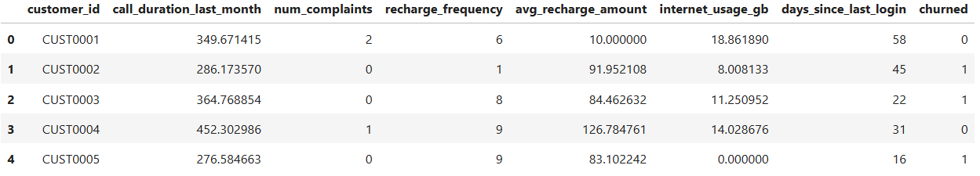
Dataset
Source: Internal customer records from a telecom company.
Target Variable: churned (1 = churned, 0 = retained).
Features: 19 predictive variables including usage patterns, service subscriptions, and customer demographics.
Total Records: Over 7,000 customers (exact number from dataset).

Slide 4
Data Preprocessing
Removed customer_id as it does not contribute to predictive performance.
Normalized numerical features using Standard Scaler to ensure consistent scale across variables.
Split the dataset into 80% training and 20% testing sets to enable robust model evaluation.

Slide 5
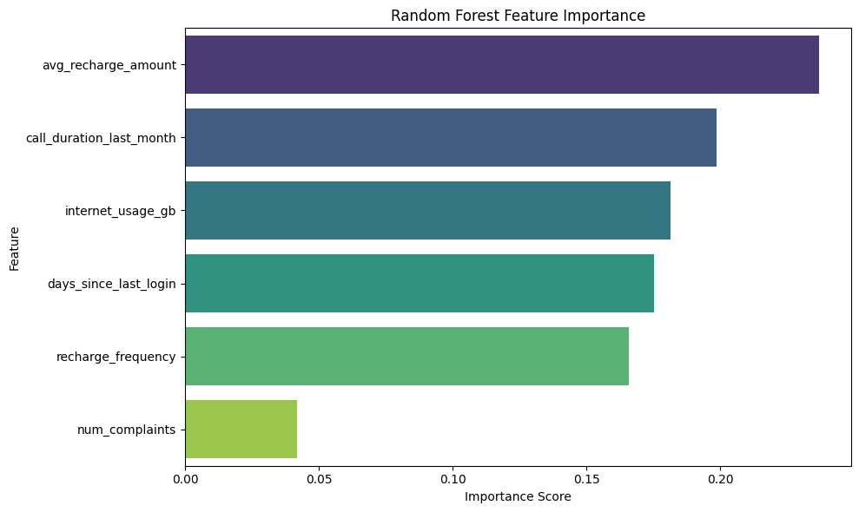
Data Frame for plotting

Slide 6
Exploratory Data Analysis
Churn distribution was assessed to understand class imbalance and guide model evaluation strategy.
Identified key features influencing churn, notably Contract type and Tenure.
Included visualizations:
Churn % by Contract Type: Highlighted higher churn among month-to-month users.
Tenure vs Churn: Revealed that customers with shorter tenure are more likely to churn.
These insights informed both feature engineering and business recommendations.

Slide 7
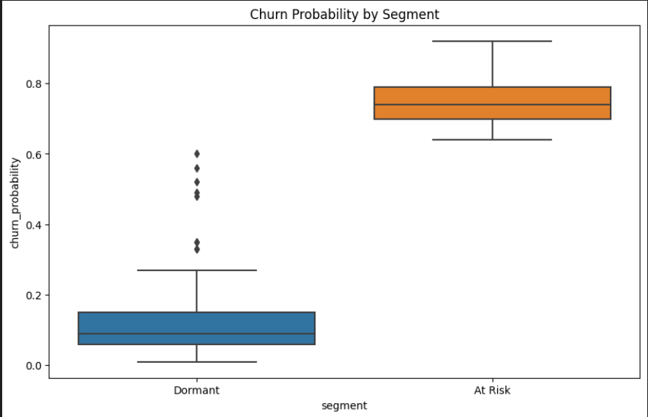
Churn probability vs Recharge Frequency

Slide 8
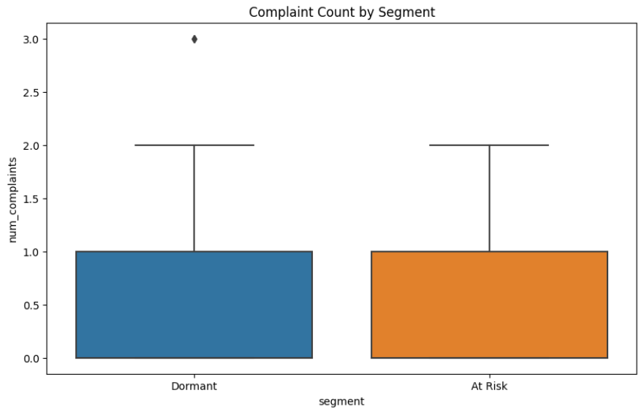
Churn probability vs Complaints

Slide 9
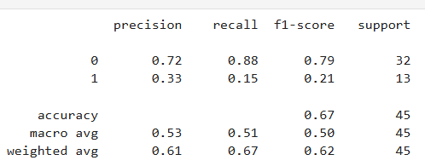
Model Building
Multiple algorithms were evaluated, including Logistic Regression, Random Forest, and XGBoost. The best-performing model was selected based on F1 score and AUC, ensuring a balanced trade-off between precision and recall while maintaining strong overall predictive power.

Slide 10
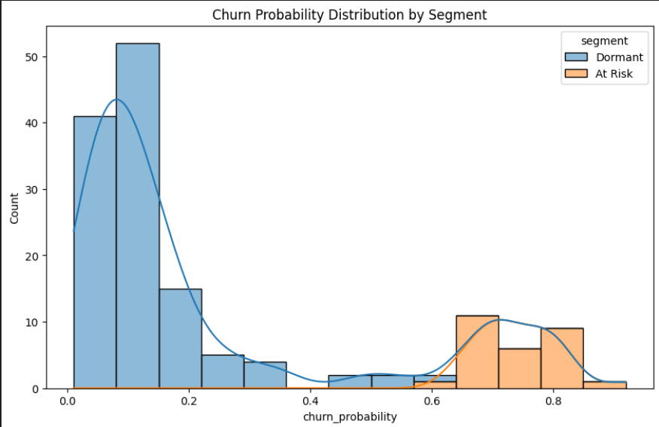
Churn Probability Distribution by Segment

Slide 11
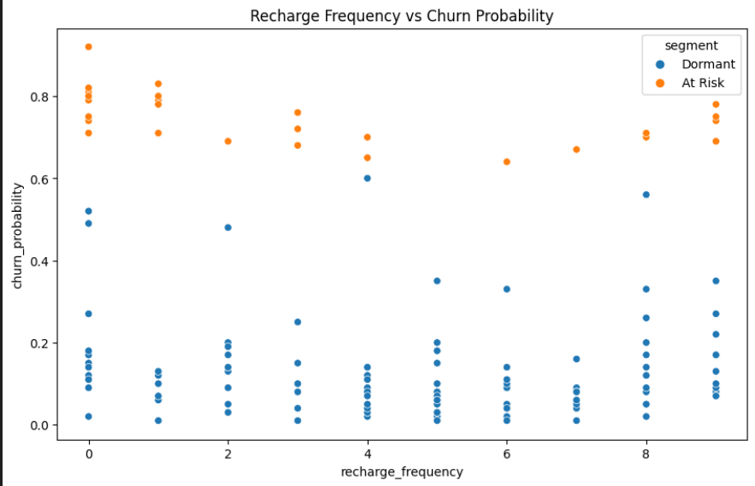
Recharge Frequency vs Churn Probability

Slide 12
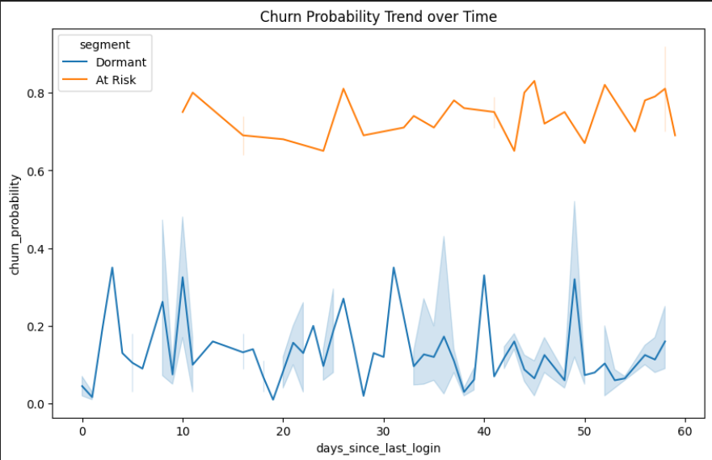
Churn Probability Trend over Time

Slide 13
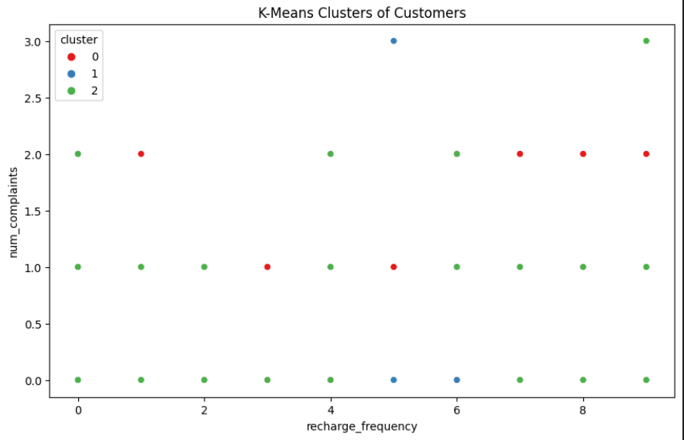
K-Means clustering

Slide 14
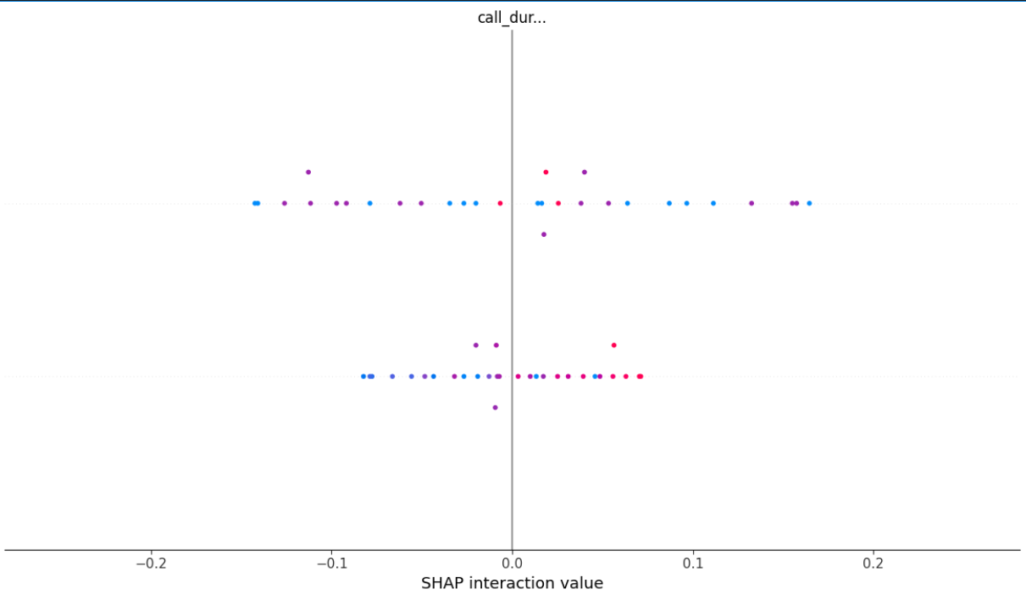
Model Explainability
Used SHAP / ELI5
Understand how features impact individual predictions

Slide 15
Recommendations
To effectively reduce churn, focus retention strategies on the following customer segments:
Month-to-month subscribers: These customers are more likely to churn due to low commitment; consider incentives to increase contract duration.
High-billing customers: Their churn represents higher revenue loss; prioritize personalized engagement and value-added services.
New users (<6 months tenure): Early-stage users are at higher risk; implement on boarding improvements and proactive support.
Additionally, offer discounts on long-term contracts to encourage commitment and improve customer lifetime value.

Slide 16
Conclusion
We successfully built a predictive model with an AUC of 83%, demonstrating strong performance in identifying potential churners. Key drivers of churn were identified, providing valuable insights into customer behavior. Based on these findings, targeted business strategies were proposed to effectively reduce churn and improve customer retention.

